Slide 1


Disease Detection Using Deep Learning
Sourabh Patil (1545)
Ashish Singh Rao (1505)
Prashant Karhale Akshay Tilekar (External Guide)
Center Coordinator
Presented by:

Slide 2
Introduction
Disease Detection Using Deep Learning
With big data growth in biomedical and healthcare communities, accurate analysis of medical data benefits early disease detection, patient care and community services.
Detection of disease through some technique is beneficial as it reduces a large work of monitoring every symptom for disease, and at very early stage itself it detects the disease that is appear on person’s body and their internal conditions.
Artificial neural network models were developed to perform disease detection and diagnosis using different symptoms of person’s through deep learning methodologies. So that appropriate medicine can be used to prevent further damage to health from different viruses.

Slide 3
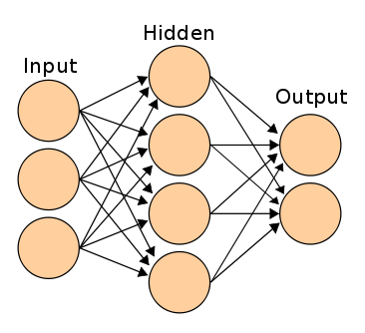
Artificial Neural Network
Disease Detection Using Deep Learning
Artificial neural networks (ANN) are used for modelling non-linear problems and to predict the output values for given input parameters from their training values.
Institute for Advanced Computing and Software Development, Akurdi

Slide 4
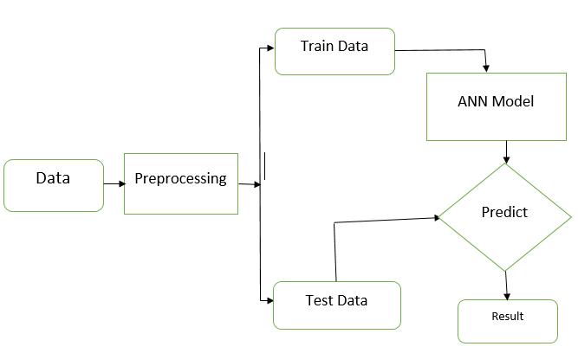
Proposed Methodology
Disease Detection Using Deep Learning

Slide 5
Dataset
Disease Detection Using Deep Learning
Independent Data | Target Data
‘itching', 'skin_rash', 'nodal_skin_eruptions', 'continuous_sneezing', 'shivering', 'chills', 'joint_pain', 'stomach_pain', 'acidity', ……., 'red_sore_around_nose', 'yellow_crust_ooze' | 'prognosis'
Data is in non-metric format i.e. 0 and 1. | There are 41 classes for target data.

Slide 6
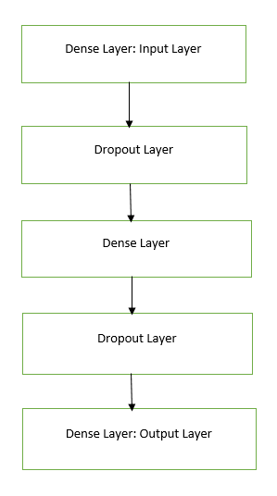
ANN Operation:
Disease Detection Using Deep Learning
Dense Layer
ReLU Layer (Rectified Linear Unit)
Dropout layer

Slide 7
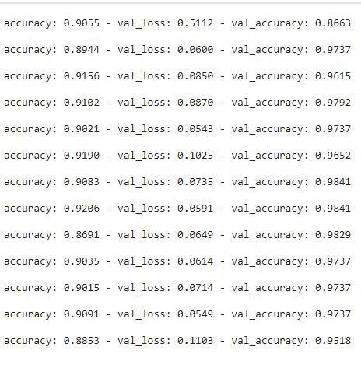
Accuracy
Disease Detection Using Deep Learning
Training Accuracy is 88%
Testing accuracy 95%

Slide 8
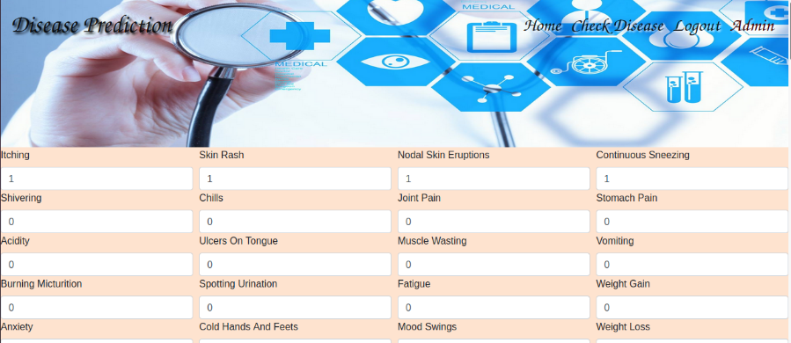
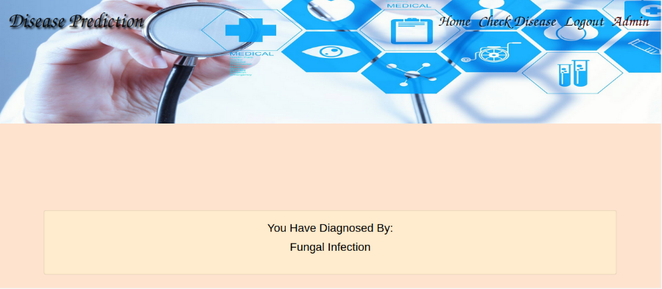
User Interface
Disease Detection Using Deep Learning
Input Page and Result Page

Slide 9
Conclusion :
Disease Detection Using Deep Learning
This system has utilized deep learning capabilities to achieve human disease detection system. This system is based on a simple classification mechanism which exploits the feature extraction functionalities of ANN. For prediction finally, the model utilizes the fully connected layers
The system has achieved an overall 95% testing accuracy on publically accessible dataset.
It is concluded from accuracy that ANN is highly suitable for human disease detection. This system can be used in hospitals and medical centres for easily disease detection.

Slide 10
Future Aspects
Disease Detection Using Deep Learning
Ordering Medicine from ecommerce site.
Mobile application for personalized use
Setting reminder for Medicine intake.

Slide 11
Thank You
Disease Detection Using Deep Learning

